Slide 1
Continuity of Operations Planning (COOP)

Slide 2
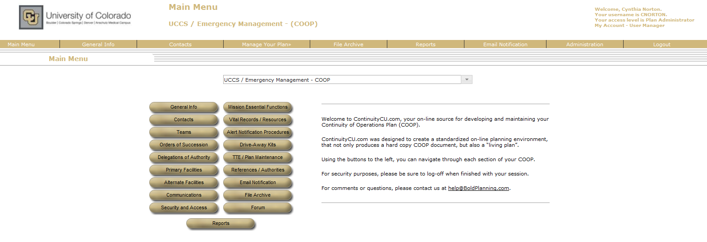
Opening Screen
If you cannot select your plan – contact Tim Stoecklein or Jamie Duvall
Your plan name should show up here – if not select the arrow and select your plan

Slide 3
You can access the various sections either from the menu at the top of the screen or from the buttons in the center of the screen

Slide 4
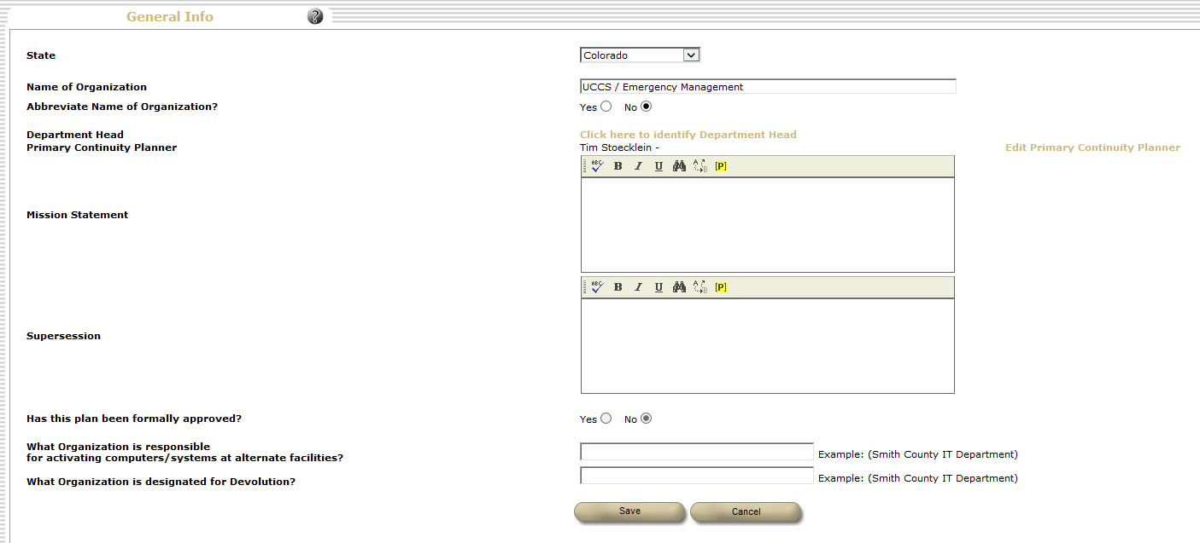
Let’s look at each section –
Anytime you see a gold – click here – it will link you to a list that you can select from – generally you will not be able to free type in this area
These are open text typing boxes

Slide 5
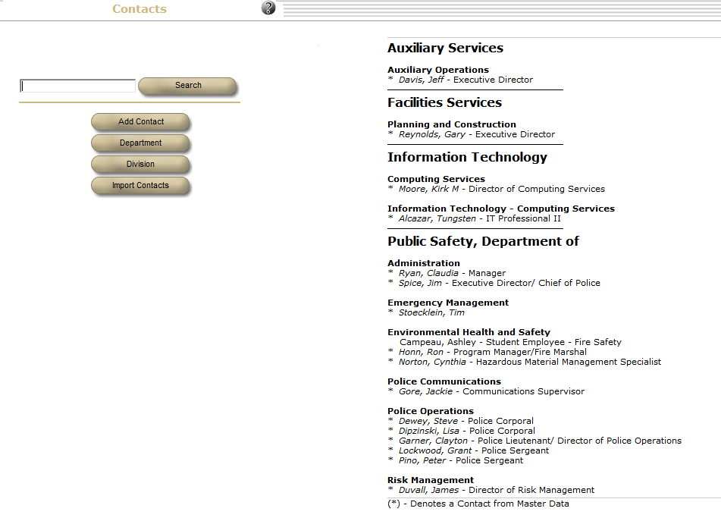
In order for you to be able to link to people in other locations within your plan, they have to be listed here.
Add a contact, department or division by selecting these buttons
The search button allows you to locate someone listed on your contact list
Key campus personnel, department heads, etc. have been preloaded into the database – you can import these contacts by selecting this button and then selecting the individuals you want to add
Before adding individuals check to see if they are already in the database

Slide 6
If you need to make changes to anyone who has a * beside their name (loaded from the master data)- send this information to Emergency Management eprepare@uccs.edu so we can update the Master data file
If you have a large organization (Example: 50+ Personnel), it is not necessary to type all 50 people into the Contacts Database. As a suggestion, only add those personnel who are directly mentioned within the plan to the Contacts Database. The other personnel and their contact information can be easily managed by uploading a spreadsheet to the FILE ARCHIVE section of the system. Using this approach, you can easily update your organizations Personnel information on a timely schedule by deleting the old spreadsheet and uploading the new, thereby alleviating the need to constantly update the Contacts Database to keep up with turnover in your organization

Slide 7
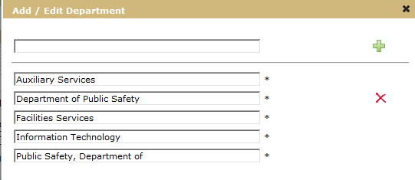
To add – edit – delete a department or division
simply click the associated button
a screen will pop-up
enter the desired information
Click plus (+) – keep repeating this until all departments/divisions have been added
click save
clicking the close button – closes the screen without keeping any edits (deletes and adds are kept)
To delete a department/division – use the red x – you can only delete a grouping which has no contacts under it

Slide 8
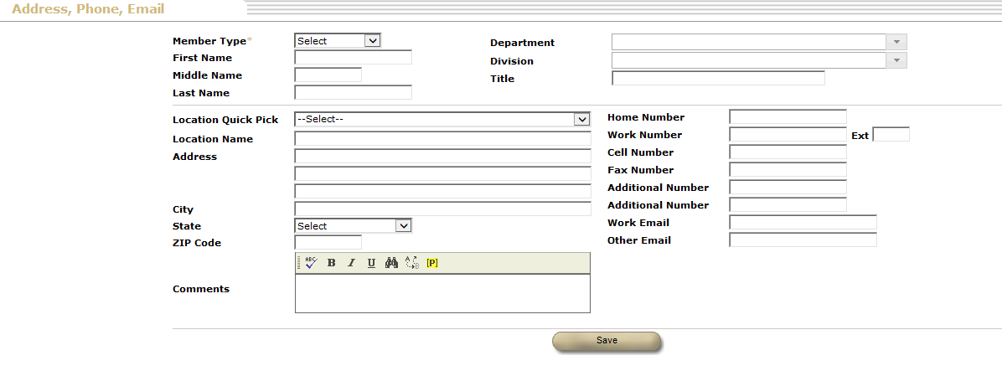
To add – edit – delete a contact
simply click the associated button
a screen will pop-up
enter the desired information
click save
To delete a contact – select delete – only appears when editing a contact
To exit without entering a contact – select any gold colored tab at the top of the screen
Use pull-downs when they are present

Slide 9
TEAMS –
The executive team is set at the master level and you cannot change this or add members to that team
The relocation – support – planning teams are suggested teams – you can add members to these teams or delete these teams – you can also add additional teams

Slide 10
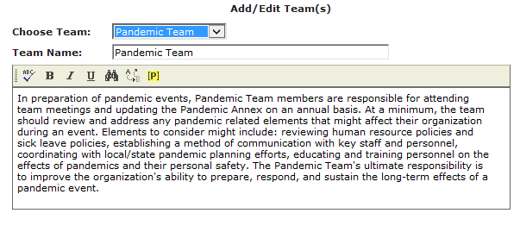
When you add a team you are asked to also provide a description of that team’s purpose

Slide 11
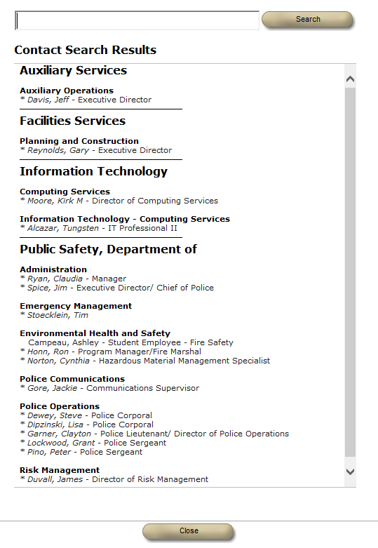
Once you have teams in place, then you can start to assign members to that team – reminder – a person has to be in your contact list in order to be placed on a team
To add the person to a team – click on their name

Slide 12
A screen will pop-up –
Select the team you want this person on
If it is the relocation/support/planning team – then roles will be listed and you can simply check the box
Otherwise you will need to type in the person’s role/responsibility on this team – this should be in bullet format (see next slide)

Slide 13
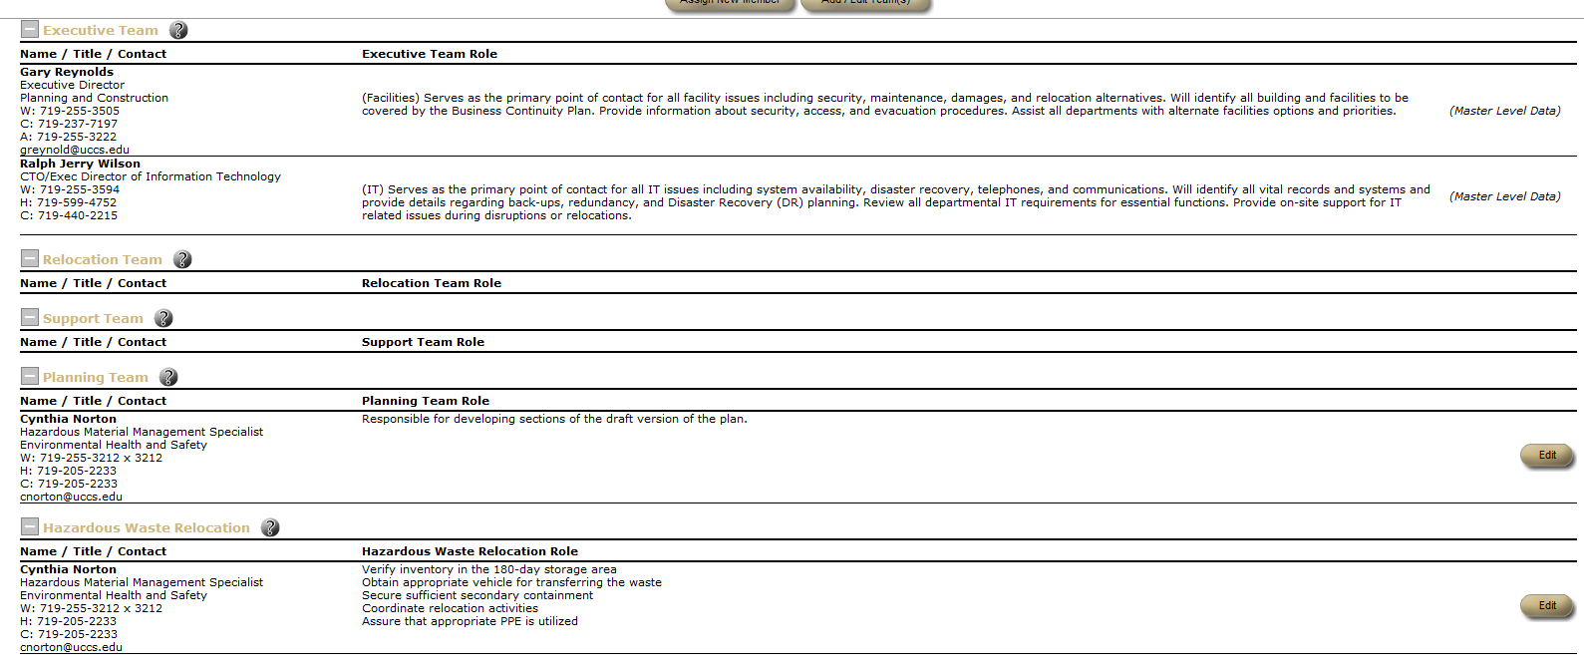
Your team list may now look something like this
You can edit team member roles by selecting the edit button beside their name
Bullet type roles

Slide 14
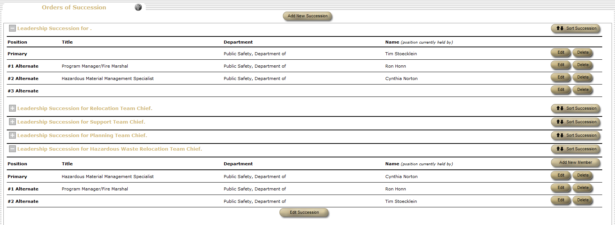
Orders of succession – essentially who is the primary person and who takes over for them when they are not available

Slide 15
To add a new succession – select the button
You should have a succession for each team that you have previously created
Expand or contract the succession with the +/- button

Slide 16
You can reorder the succession by selecting “sort succession”
A new screen appears – drag the list into your desired order and hit save
This is now your new order of succession

Slide 17
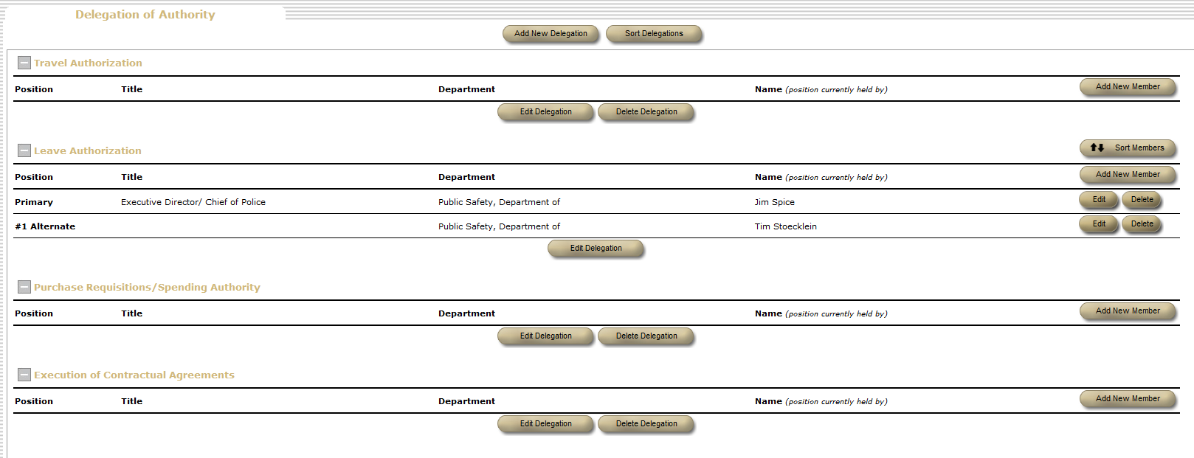
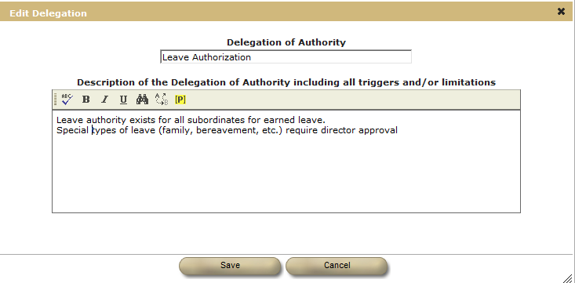
Delegation of authority – start here with who currently has this authority
You can reorder the members

Slide 18
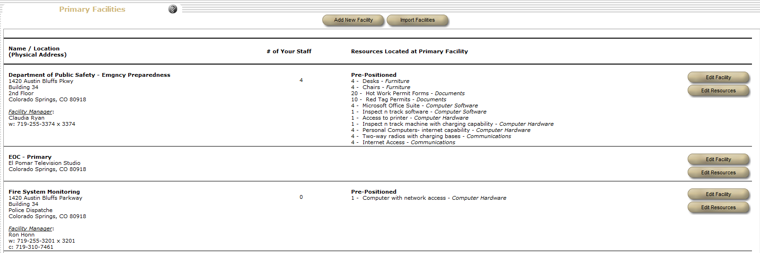
Primary Facilities
This is a listing of every facility that your organization has
Start by selecting the building from Import Facilities – then edit facility name to reflect your facility description and after the line with building number add your room, floor, section, etc.
List only facilities assigned to your organization. Do not list common use classrooms (i.e. Columbine 126) but you would list Columbine 135 (darkroom) since it has an exclusive department use

Slide 19
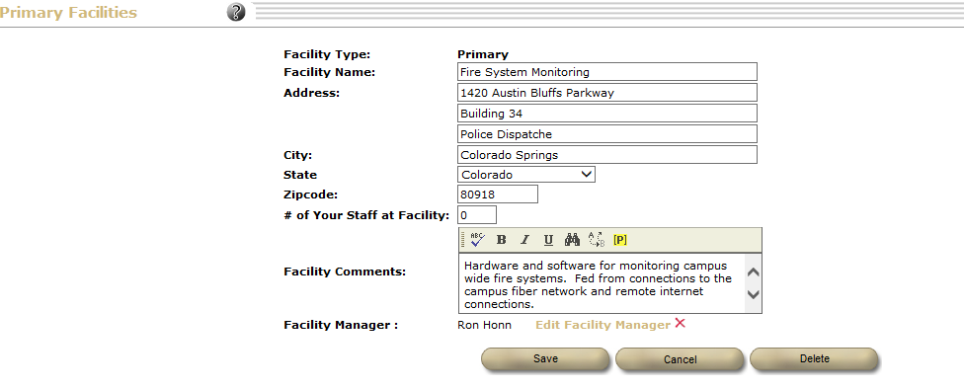
Adding/editing primary facilities
Important note: save before adding facility manager or all your edits will disappear –
To add facility manager go back in and edit
Change bldg. name
Add section, room, etc.
Identify # of people in this space
General description of use – unique features
Select facility manager from contacts

Slide 20
Once your facility is identified – you need to edit resources
You can duplicate resources from one facility to another by using the import resources – this will duplicate whatever is listed for one facility into the current facility – you can then delete (red x) those things that don’t apply
To enter new resources – type in a description – use the pull down menu to select type and press green +
These are the things you need to do your job
For your primary facility everything will show as pre-positioned

Slide 21
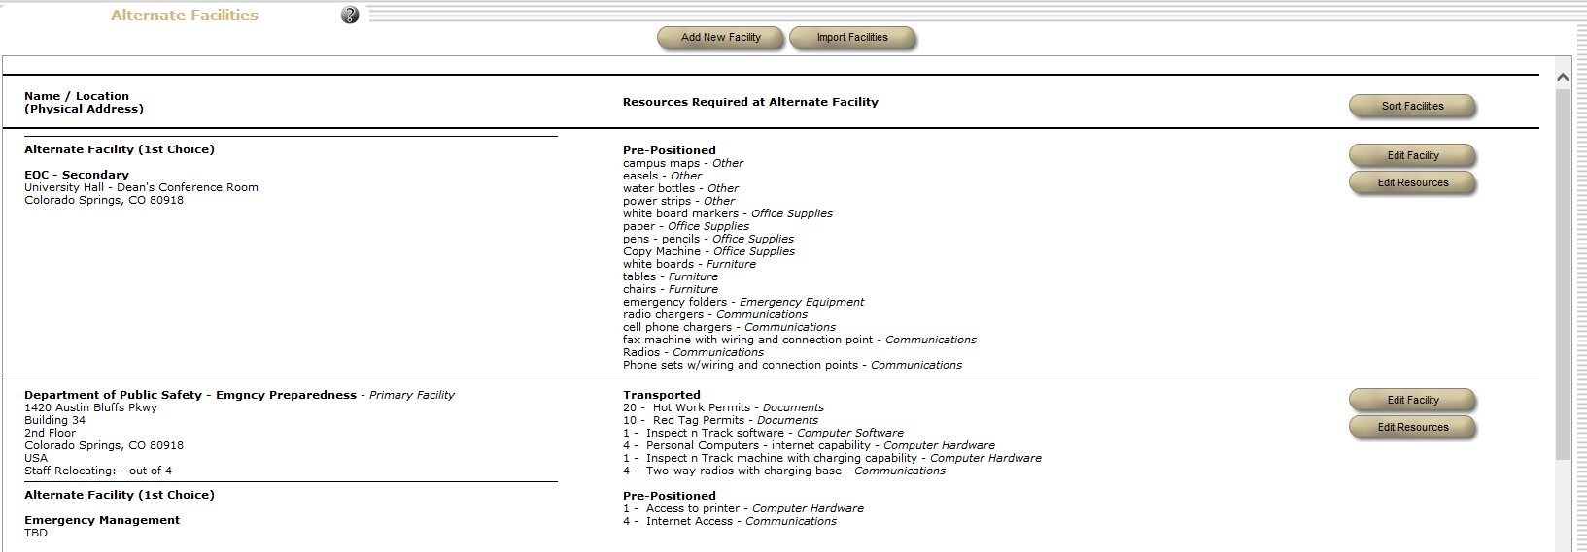
Adding/editing alternate facilities
Each primary facility needs an at least 1 alternate facility – you can designate up to 3 locations
You may know your preferred location – or you may not
Identify the resources needed to do your job – this is a great time to import resources from the primary facility
You will need to indicate if the item is pre-positioned or transported

Slide 22
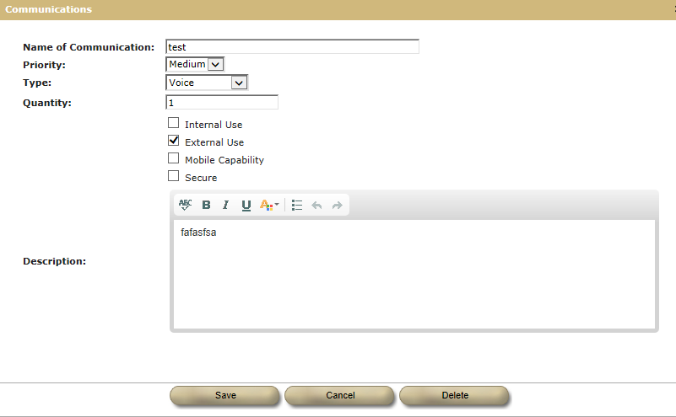
Communications
This is where you would have pre-planned messages – or other forms of communication that you might potentially need to send out

Slide 23
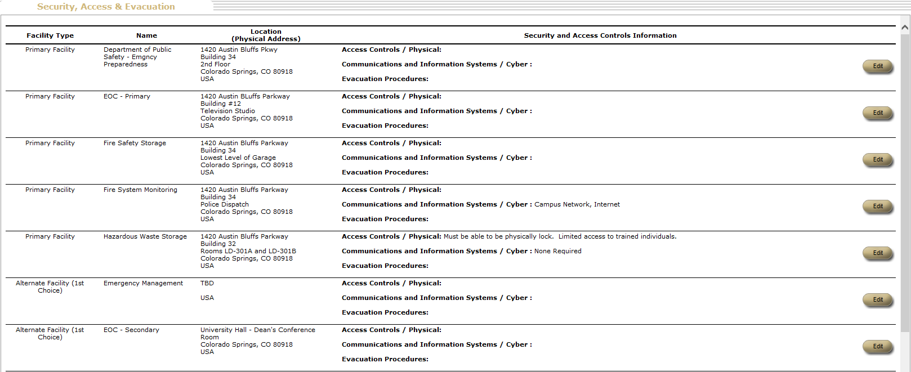
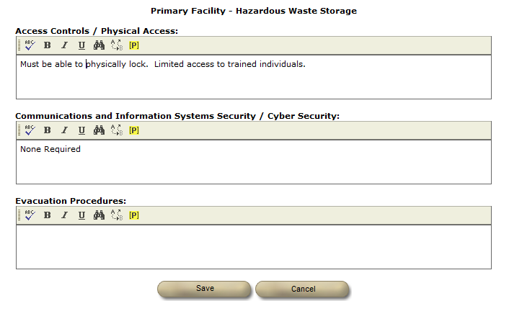
Each primary and alternate facility will be listed here
You need to add security, access and evacuation information to each

Slide 24
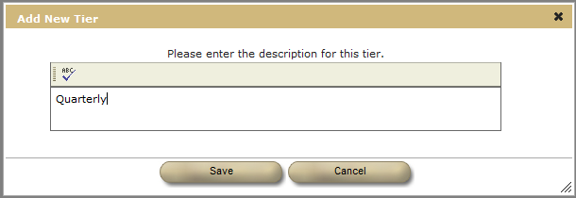
Mission Essential Functions
These are the basics that your organization has to do
You can add as many tiers as you like but we recommend at least the first 3
We want it here so we would sort tiers and drag them into the order we want

Slide 25
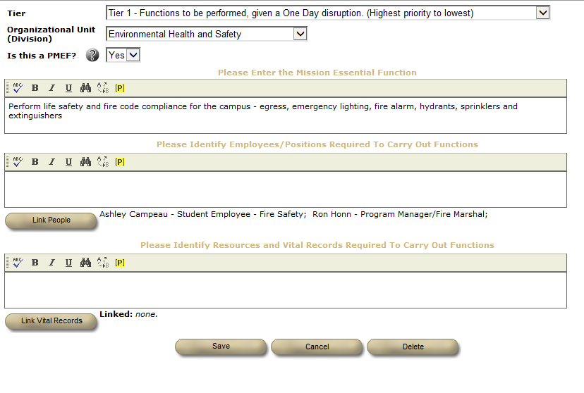
Once you have tiers built – you start adding functions
Select the tier from the drop down
Select the unit responsible
See next slide for explanation of this
Whenever possible use the link to pull people from your plan – but you can free type anyone who is not in your plan
Once we have entered resources and vital records in the next section you will be able to link to them here – you can free type here also

Slide 26
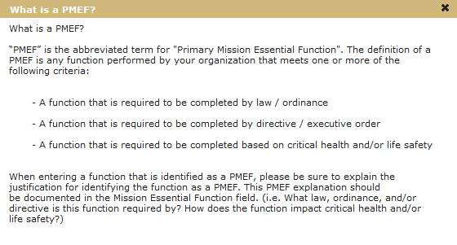
By pressing the enter key put the regulation, law, etc. on a separate line at the end

Slide 27
This is what a finished tier might look like – you can reorder the functions by using the sort button and dragging them into the order you desire them to be in

Slide 28
Vital Records/Resources
"Vital Records" are the important items your organization requires to operate. Some examples of Vital Records could include spreadsheets, databases, software/systems, specialized programs or any other items your organization relies upon to operate. Keep in mind: Vital Records are not just electronic documents; they could also include maps, manuals, or other types of printed materials.
Your COOP plan should contain a prioritized list of the Vital Records your organization uses based on their importance. For each Vital Record you should identify what the Vital Record is, how it is used within the organization, how the Vital Record is stored/backed-up, and who to contact during a COOP event to gain access to the stored version. Here are some questions to consider for each Vital Record:
-What Vital Records do we use to operate?
-Where do we keep each back-up of our Vital Records and who keeps them? (Hint: If you find that you do not have a back-up process for a Vital Record, you should start a process)
-How often is each Vital Record backed up? Is it a manual process or automated?
-Who do I contact to request back-up versions; what's their email and phone number?
***Assume your office space had a small fire overnight. Upon returning to work, what items would you instinctively reach for to conduct your job that would no longer exist? What items are you used to having on your desk, computer, around the office that would be difficult to operate without? (These items are the starting point to your list of Vital Records)
Some records/resources can be imported from a master list – or you can add them in directly

Slide 29
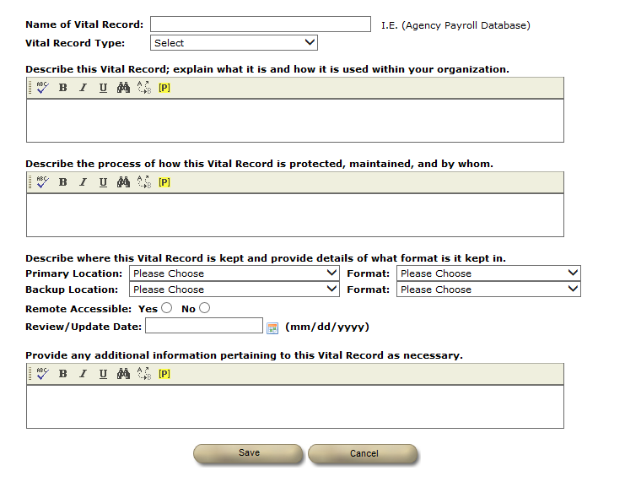
Adding Vital Records/Resources
Identify the name of this record and select its type
text type-in
text type-in
Use pull-on menus
text type-in

Slide 30
Alert Notification Procedures
System set
Identify how and who will notify different parts of your team
Dept. input

Slide 31
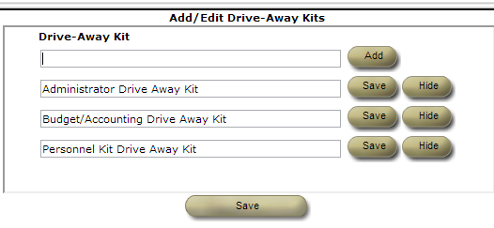
Drive Away Kits
Note if this module gives you problems switch to Chrome
There are 3 types of drive away kits pre-loaded in the plan
Administrative
Budget/Accounting
Personnel
You can also add your own type of kit
For the pre-loaded kits – you can hide the entire kit

Slide 32
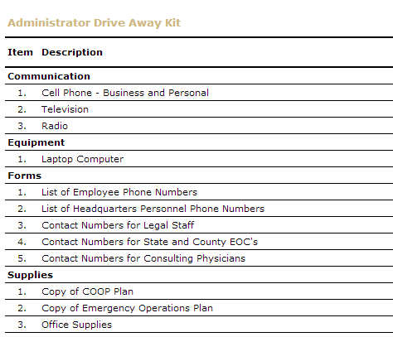
Pre-Loaded Drive Away Kits
You need to either add a quantity to the item or hide the item
After the initial add – if you edit an item – you have to hit “save” for it to stay
You can also add your own items and/or provide additional information for pre-loaded items
This is a unique screen which requires you to either use the back arrow key on your browser or select like Main menu on the gold bar to leave this page

Slide 33
What should be in these kits?
Look at this way – if you had 15 minutes to pack the things from your office which would be critical to you being able to do your job for the next 48 hours and which are not easily replaced/borrowed, what would they be?
Remember you need to be able to carry/move in your hands/car.
Things you might want to take:
Radio and charger
Cell phone and charger
Paper records (vital like personnel files, contracts) which may be either needed or for which there are no electronic backups
Things that could be replaced
Office supplies
Computers
Copy machines
One example from a training was the printing plates required for printing any kind of check – 6 week lead time

Slide 34
Example of a personnel kit

Slide 35
TTE/Plan Maintenance
This is where you can record table top exercise full scale exercise system test training plan maintenance continuity event/activation other
You can also set-up reminders for the system to send you messages to update your plan
Completed or scheduled

Slide 36
References/Authorities
AUTHORITIES - Identify any Authorities that "direct" your organization towards creating and maintaining a Continuity of Operations Plan. These authorities could include laws, ordinances, executive orders, or other legal type initiatives mandating the COOP/emergency planning requirements. REFERENCES - Identify any related Reference documents that pertain to the contents of your plan. Examples of Reference documents might include: -Emergency Operations Plans -Comprehensive Emergency Management Plans -Facility Evacuation Plans MEMORANDUMS OF UNDERSTANDING - Identify any Memorandums of Understanding (MOU) that have been developed between your organization and other MOU partners (departments, agencies, other jurisdictions). MOUs are the written documents that describe a bilateral or multilateral agreement and are used to spell out in writing a relationship between partners that have agreed to share/provide resources during a time of disruption. MOU are helpful in providing a clear understanding of each party's commitment and level of agreed assistance should certain types of events occur.

Slide 37
References/Authorities
There are 3 pre-loaded authorities and references – you can add additional

Slide 38
Email notifications
Only action for this section is to ensure that all your contacts have valid email addresses (business and personal)
The Email Notification feature is designed to provide users with an extra layer of communication during times of disruption. For each contact person contained within the contacts database of the system, we provide two distinct email data fields (business email/personal email). As a standard, when emails are sent from the system, the message is sent to both the recipient’s business email, as well as their personal email. This coverage helps to better ensure the message is successfully delivered to recipients even during times of disruption when the business email system might not be operational or possibly inaccessible to personnel. When sending an email through the system, user’s have the option of sending the message to a single individual, as well as sending a message to any predefined groups or teams created within their plans. The emails that are sent to recipients will be addressed as coming from "notify@ ContinuityCU.com" with a signature line at the conclusion of the message identifying the name of the specific sender and their email address. If a recipient replies directly to the message, the reply will be automatically redirected to the email address of the sender who sent the initial message. Finally, the Email Notification feature is powered independently by the ContinuityCU.com email system. Therefore, any email service outages that an organization might face can be circumvented through the use of the system. Simply stated, if users have access the internet, they can successfully access the Email Notification feature to communicate and/or access any part of their plans as necessary.

Slide 39
File Archives
This works essentially like a remote drive
You can create a file structure by adding folders and then upload files
These files are stored on a remote secure system separate from the university.
You should put copies of electronic files that:
You need to do your job
Need backed up
Need access to if the university system was down
This system is a little unique in that a folder will not appear on this page unless it has a file in it (not in its subfolders). The subfolders will appear to be under the wrong folder.

Slide 40
This is a discussion forum where you can post things and people can respond to them. You can control how many posts you are seeing

Slide 41
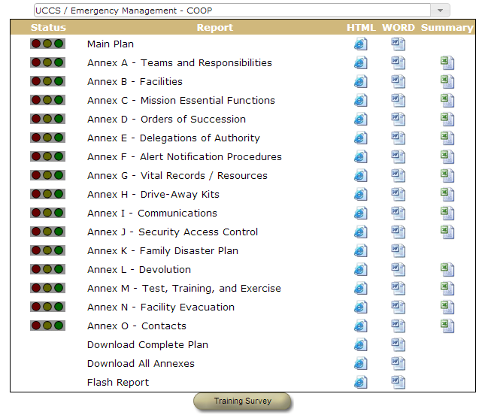
This is where you can see how all of the information that you have been inputting will fit into the report/plan format. You can view it in 3 formats and save it in a Word or Excel format

